Slide 1
The TECHNICAL STYLE

Slide 2
Style in Writing
Consider the following,
Vocabulary: type, sophistication, complexity (long, multisyllabic words)
Sentences: length, structure, impact (how is the key information arranged and communicated)
Document structure (layout and presentation of information): headings, font, format

Slide 3

Can we have a technical and general description on the following image?

Slide 4
Compare the style
TEXT A
One enters the palatial room through an elegantly carved maple door to reveal the French provincial furniture of another century. The plush beige carpet makes one want to run and dance barefoot.
TEXT B
The entrance to the 24-ft room is a 36-in. by 80-in. maple door decorated with a carved family crest. The floor has a beige nylon carpet with a 1-in. pad. The furniture is French provincial.

Slide 5
The TECHNICAL STYLE
The following acronym sums it all up,
SCOPE

Slide 6
Examples for Acronym
NASA-National Aeronautics and Space Administration
IELTS-International English language Testing System
SWOT-Strengths, Weaknesses, Opportunities, Threats

Slide 7
This is SCOPE
S- Simplicity
C- Clarity
O- Objectivity
P- Precision
E- Economy

Slide 8
We will change the order to study.
Clarity
Precision
Simplicity
Objectivity
Economy

Slide 9
1. CLARITY
Getting the meaning from your head to the head of your reader accurately is the purpose of clarity.
Consequences of lack of clarity:
If the audience responds to a memo, letter, report, or manual with, “Huh?” what has the writer accomplished? If the correspondence is not clearly understood, the reader will either call the writer for further clarification, or just ignore the information. In either case, the writer’s time is wasted; the reader’s time is wasted; the message is lost.

Slide 10
Four key elements to ensure clarity
1. Completeness
2. Correct Grammar
3. Clear organization of Content
4. Clear Pronoun References

Slide 11
1. Completeness
The information provided should answer all the wh-questions.

Slide 12
Compare the following
Version 2
Version 1
Date: March 5, 2004
To: Michelle Fields From: Earl Eddings
Subject: Meeting
Please plan to prepare a presentation on sales. Make sure the information is very detailed. Thanks.
Date: March 5, 2004 To: Michelle Fields From: Earl Eddings Subject: Sales Staff Meeting
Please make a presentation on improved sales techniques for our sales
staff. This meeting is planned for March 18, 2004, in Conference Room C,
from 8:00 a.m. - 5:00 p.m.
Our quarterly sales are down 27%. Thus, we need to help our staff accomplish the following: 1. Make new contacts. 2. Close deals more effectively. 3. Earn a 40% profit margin on all sales.
Use our new multimedia presentation system to make your presentation. With your help, I know our company can get back on track.
Thanks.

Slide 13
2. Correct Grammar
This includes:
The structures (tenses, voice, conditionals), articles, prepositions, modal verbs
Sentence structure (the conjunctions, clauses, punctuation, avoidance of sentential errors)
Other mechanics and punctuations

Slide 14
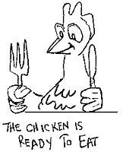

Slide 15
3. Clear Organization of Content
This includes,
Coherence
The effective writing process
Clear paragraphing

Slide 16
Example for content organization
The flawed organization of the paragraphs
Dear Liz,
¹Our laboratories investigated the cause of the Model 24-C control panel fires by testing 12 prototypes under normal operational and emergency loads. ²We recommend that this junction be redesigned and retested to minimize the possibility of future fires.
³The test results included in this report consistently demonstrate inadequate wiring for emergency loads at the terminal junction. This finding confirms our preliminary analysis.
Truly yours,
Carol Stacy

Slide 17
Re-organized email,
Dear Liz,
¹Our laboratories investigated the cause of the Model 24-C control panel fires by testing 12 prototypes under normal operational and emergency loads. ³The test results included in this report consistently demonstrate inadequate wiring for emergency loads at the terminal junction. This finding confirms our preliminary analysis.
²We recommend that this junction be redesigned and retested to minimize the possibility of future fires.
Truly yours,
Carol Stacy

Slide 18
4. Clear Pronoun References
A pronoun should refer clearly to its antecedent.

Slide 19
Ambiguous
Implied
Vague

Slide 20
A. Ambiguous Reference
An ambiguous reference occurs when the pronoun could refer to two possible antecedents.
For example:
The client told James that he had to come to therapy.
(Who has to come to therapy- the client or James?)
The following revision eliminates the ambiguity.
The client told James, “You have to come to therapy.”

Slide 21
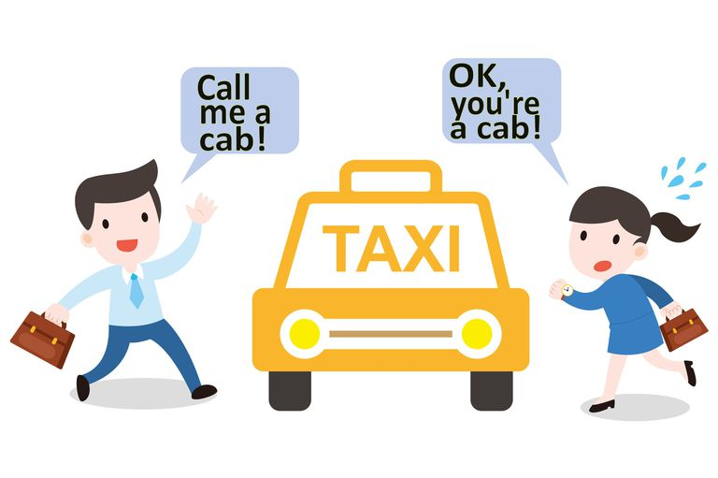

Slide 22
B. Implied Reference
A pronoun must refer to a specific antecedent, not to a word that is
implied but not present in the sentence.
For example:
After braiding Ann’s hair, Sue decorated them with ribbons.
The pronoun them refers to Ann’s braids (implied by the term
braiding), but the word braids did not appear in the sentence.
In Nikki’s case file, she describes how Ms. Jones abuses
substances.
The pronoun she does not refer to Nikki but refers to Nikki’s case file.
In Nikki’s case file, Nikki describes how Ms. Jones abuses
substances.

Slide 23
C. Vague Reference: this, that, which (contd.)
The pronouns this, that and which should not refer vaguely to earlier word groups or ideas. These pronouns should refer to specific antecedents.
When a pronoun’s reference is too vague, replace the pronoun
with a noun.
For example:
“More and more often, especially in large cities, we are finding
ourselves victims of serious crimes. We learn to accept this
with minor complaints.”
Revised:
More and more often, especially in large cites, we are finding
ourselves victims of serious crimes. We learn to accept our
fate with minor complaints.
(The pronoun this is replaced by the noun fate).

Slide 24
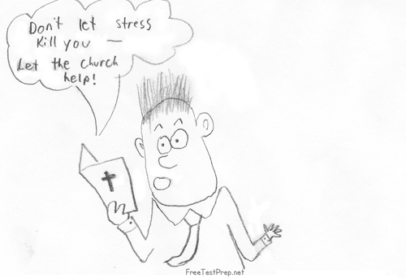

Slide 25
C. Vague Reference: this, that, which
When a pronoun’s reference is too vague, supply an antecedent to which the pronoun clearly refers.
For example:
Sue and Patsy were both too young to have acquired much wisdom, which accounts for their rash actions.
Revised:
Sue and Patsy were both too young to have acquired much wisdom, a fact which accounts for their rash decisions. (The pronoun which clearly refers to the supplied antecedent, fact).

Slide 26
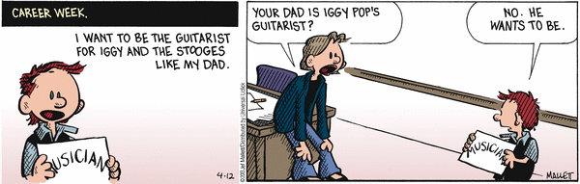

Slide 27
Activity
You are the president of an industry association and have received the following inquiry from an out of town member, “I think I would like to attend my first meeting of the association even though I am not acquainted with your city. Will you please tell me where the next meeting is being held?”
Compose an email on the above situation.

Slide 28
PRECISION
Precision refers to exact, definite, and distinct terms/words/details for expressing an idea. It will leave no room for misinterpretation or multiple interpretations.
SET 1 | SET 2
Some of our competitors have very good businesses. As we discussed recently, I have the figures on the projects. The policy change will affect us adversely. | Both Sunbelt Instruments, Inc. and Ohio Testing laboratories grossed over $6.2 million during the fourth quarter of last year. I have discussed the comparative costs of three word processing computers which you requested in our telephone conversation last Friday. New Policy 1204.05 (Leaves) will decrease our allowable sick days from 10 to 8 per year.

Slide 29
2 key elements to achieve precision
1. Concrete and specific words.
2.Specific Facts and Figures.

Slide 30
PRECISION
1. Choose precise, concrete, and specific words.
Vague and Ambiguous | Clear and Precise
The flow of lava was affected. | The flow of lava was decreased.
The lacquer created nice appearance. | The lacquer created a glossy appearance.
Since the component was rejected, a new manufacturing process was developed. | Because/After the component was rejected; a new manufacturing process was developed.
This is the last carburetor to be installed. | This is the most recent carburetor to be installed.

Slide 31
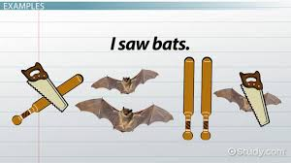

Slide 32
PRECISION
2. Use Specific Facts and Figures.
Vague, General, Indefinite | Concrete, Precise
This is a long letter. | This letter is three times as long as you said it would.
Student GMAT scores are higher. | In 1996, the GMAT scores averaged 600; by 1997 they had risen to 610.

Slide 33
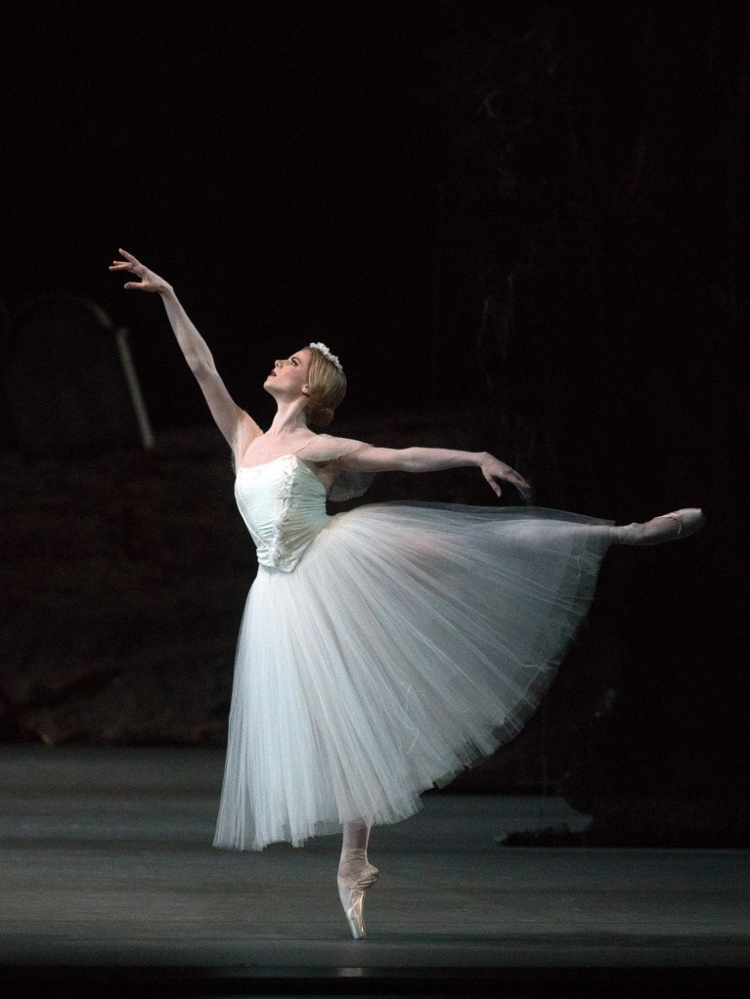
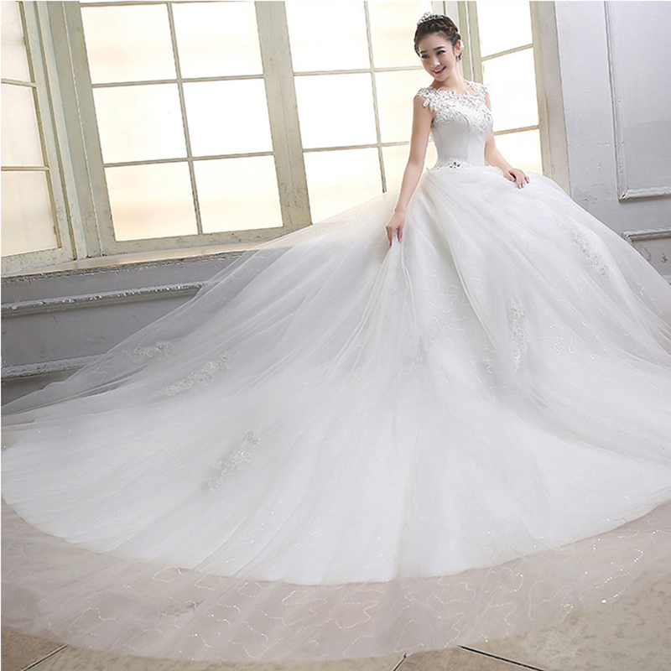
How would you describe the following pictures with precision?

Slide 34
PRECISION
The following passage is not specific in details. Replace the underlined words with precise information.
Our latest attempt at molding protectors has led to some positive results. We spent several hours in Dept.15 typing different machine settings and techniques. Several good parts were molded using two different sheet thicknesses. Here’s summary of the findings.
First, we tried the thick sheet material. At 240F, this thickness worked well. Next, we tried the thinner sheet material. The thinner material is less forgiving, but after a few adjustments we were making good parts. Still, the thin material caused the most handling problems.

Slide 35
PRECISION
Revised version
During the week of 10/4/14, we spent approximately 12 hours in Dept. 15 trying different machine settings, techniques, and thicknesses to mold mold protectors. Here is a report on our findings.
0.030″ Thick sheet
At 240 F, this thickness worked well.
0.015″ Thick sheet
This material is less forgiving, but after decreasing the heat to 200F, we could produce good parts. Still, material at 0.015″causes handling problems.

Slide 36
SIMPLICITY
The technical style demands formal yet simple language. Use technical words only when you really need to. Avoid unnecessary jargon. Consider the following examples:
Jargonized and Pompous language | Simple and Formal
We will use the input of each department to finalize our game plan. | We will consider the suggestions of each department to complete our programming.
At this juncture, the aforementioned procedure should be utilized. | The plan which we discussed should be used now.
We should commence operational capabilities in systematic increments. | We should begin the project step by step.
It just isn’t politically correct to suggest a purchase from a company that is played. | It just isn’t smart to suggest a purchase from a company whose sales are falling.

Slide 37
Simplicity can be achieved by,
Using simple vocabulary
Using simple and compound sentence structures

Slide 38
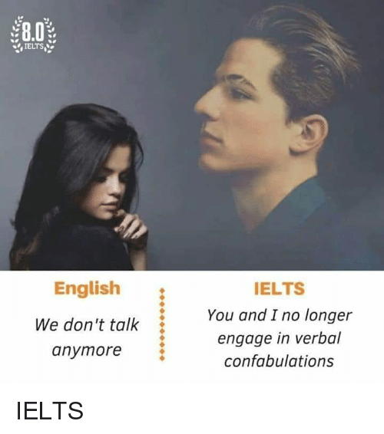

Slide 39
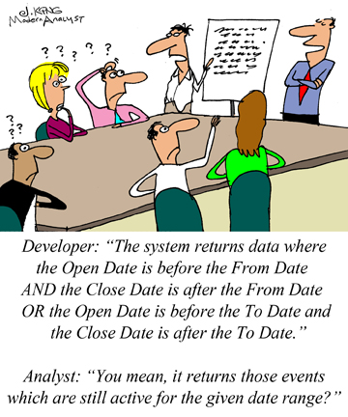

Slide 40
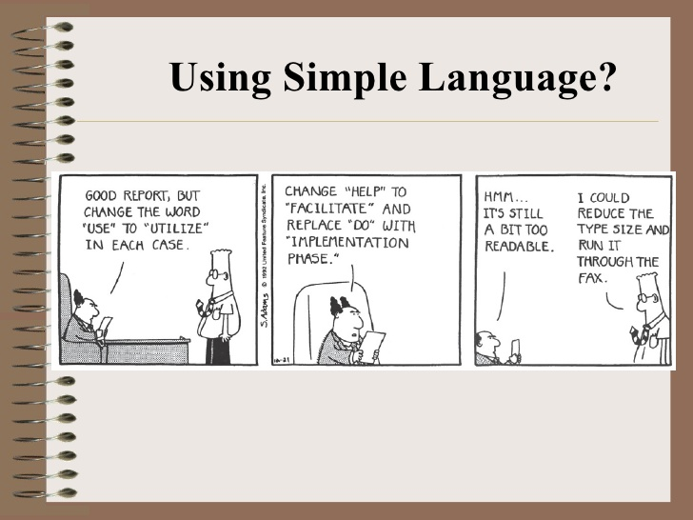

Slide 41
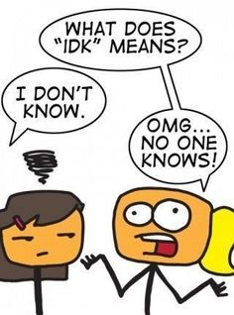

Slide 42


Slide 43
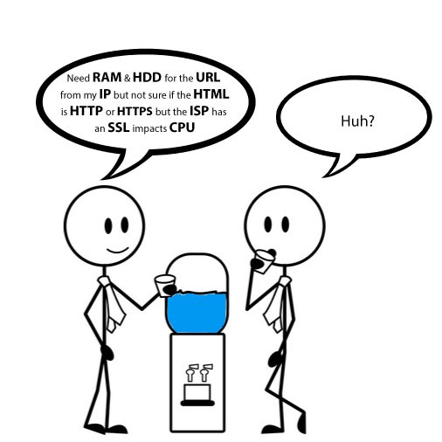

Slide 44
Re-write the following sentences by making them simple and reader friendly.
Last but not least, the article sends an important message.
My main ambition in life is not to make a fortune, since I know that, as they say, "Money is the root of all evil."
For Baldwin, the problem never reared its ugly head until one dreadful night in New Jersey.
The building's owners offered the inspectors many financial incentives to overlook code violations

Slide 45
Rephrased Sentences
1. Finally/to sum up/ to conclude, the article sends an important message.
2. My main ambition in life is not to work so that I can be millioner because I know that it will bring distress.
3. For Baldwin, the problem never occurred until one night in New Jersey.
4. The building's owners bribed the inspectors to hide the crime of code violation.

Slide 46
OBJECTIVITY
The convention of ‘objective’ writing is that arguments use impartial language, which is not a) personal, b) judgmental, or c) emotive.
Objective language is considered fair and accurate.
It avoids exaggeration and bias, and shows respect for the views of others.
Everyday language is ‘subjective’. It is used to express opinions based on personal values, beliefs or preferences rather than evidence.
Opinions tend to be based on subjective judgment rather than on information that can be verified.

Slide 47
3 ways to achieve objectivity
Personal opinion should be avoided
Judgmental language
Emotive language

Slide 48
1.Avoid personal language unless necessary Compare the examples below:
1. I got informed consent in accordance with the procedures specified for research…
Informed consent was obtained in accordance with the procedures specified for research…
2. I believe that there is a discrepancy between theory and practice…
Research suggests that there is a discrepancy between theory and practice…
3. I interviewed a total of 22 parents during the month of December 2009…
A total of 22 parents were interviewed during the month of December 2009…
4. I gave completed questionnaires a number for identification purposes…
Completed questionnaires were allocated a number for identification purposes…

Slide 49
2. Avoid Judgmental Language
Judgmental language suggests that you are making a personal judgment.
By using judgmental language, it may sound as though you have come to a conclusion based on your previously held beliefs, rather than through a review of the relevant literature.
It is important to remember that beliefs you may have held at one time could later be disproved.

Slide 50
Consider the following examples:
International schools are always elitist…
International schools are often viewed as elitist…
2. Jessen’s (1956) theory is the most influential for scholars in education
Jessen’s (1956) theory remains one of the most influential for scholars in education…
3. Smith’s (2009) paper made such a remarkable contribution to the field…
Smith’s (2009) paper made a major contribution to the field…
4. Gorard’s (1999, pp.31-33) study provided an awesome classification model…
Gorard’s (1999, pp.31-33) study provided a concise classification model…

Slide 51
3. Avoid emotive language.
Emotive language appeals to the emotions or values of your reader.
Emotive language tends to use superlatives and/or exaggeration in an attempt to incite an emotional reaction.

Slide 52
Consider the following examples:
Korean orthography is too difficult to be well-understood…
Korean orthography is not generally well-understood…
These really lucky people may be advantaged by healthcare services that…
These people may be advantaged by healthcare services that…
3. Sydney represents an incredibly vivacious school market…
Sydney represents an active and dynamic school market…

Slide 53
Re-write the following sentences by making them objective.
I don’t think that this company cares about what their customers think of them.
In my experience, they haven’t been the best.
This operating system isn’t the best one out there. It’s too slow for most people’s needs.

Slide 54
Re-write the following and make it objectively sound.
Our lives at home converged around the pleasantly-shaped kitchen table. It was the magnet that drew our family together quite warmly. Cut from the sturdiest oak, the table was tough, smooth, and long enough for my mother, my two sisters, and me to work or play on at the same time. Our favorite light blue ceramic tile, stationed in the right corner, was the table's sole defense against the ravages of everything from a steaming teapot to the latest red-hot gadget from the Sears catalogue. More often than not, however, the heat would spread quickly beyond the small tile and onto the checkered oilcloth, which just as quickly exuded a rank and sour odor. Yet no matter how intensely the four of us competed for elbow room at the table, none dared venture near the lone dinner place arranged securely to the left of the tile. There was no telling when he would get home from work, but, when he did, he expected the food to be ready--steaming hot. He liked to eat right away--steak mostly--two bloody but thick pieces.

Slide 55
Objective version
The kitchen table is rectangular, seventy-two inches long and thirty inches wide. Made of a two-inch-thick piece of oak, its top is covered with a waxy oil-cloth patterned in dark red and blue squares against a white background. In the right corner, close to the wall, a square blue ceramic tile serves as the protective base for a brown earthenware teapot. A single white placemat has been set to the left of the tile, with a knife and fork on either side of a white dinner plate, around nine inches in diameter. On the plate are two thick pieces of steak.

Slide 56
ECONOMY--Cut the clutter
The extra, unnecessary words or phrases.

Slide 57
Clutter
1. Dead weight/empty words and phrases
As it is well known
As it has been shown
It can be regarded that
It should be emphasized that
Important
Basic tenets of
2. Adverbs
very, really, quite, basically, generally, etc.

Slide 58
ECONOMY
Replace the following phrases with one to two suitable words/phrase
A majority of
A number of
Are of the same opinion
Less frequently occurring
All three of the
At that point in time
Due to the fact that

Slide 59
Cut The Clutter
Trick Set 1
Eliminate negatives
Eliminate superfluous uses of “there are/there is”

Slide 60
ECONOMY
ELIMINATE NEGATIVES
She was not often right.
She was usually wrong.
2. She did not want to perform the experiment incorrectly.
She wanted to perform the experiment correctly.
3. They did not believe the drug was harmful.
They believed the drug was safe.
■ Not harmful safe
■ Not important unimportant
■ Does not have lacks
■ Did not remember forgot
■ Did not succeed failed
■ Didn’t pay attention to ignored

Slide 61
ECONOMY
ELIMINATE SUPERFLUOUS USES OF “THERE ARE/THERE IS”
1. There are many ways in which we can arrange the pulleys.
We can arrange the pulleys in many ways.
2. There was a long line of bacteria on the plate.
Bacteria lined the plate.
3. There are many physicists who like to write.
Many physicists like to write.
4. The data confirm that there is an association between vegetables and cancer.
The data confirm an association between vegetables and
cancer.

Slide 62
Cut The Clutter
Trick Set 2
Avoid turning verbs into nouns
Use strong verbs
Don’t bury the main verb
Write with verbs

Slide 63
ECONOMY
1. Use strong verbs
Compare:
“Loud music came from speakers embedded in the walls, and the
entire arena moved as the
hungry crowd got to its feet.”
With:
“Loud music exploded from speakers embedded in the walls, and
the entire arena shook as the hungry crowd
leaped to its feet.”

Slide 64
ECONOMY
And it is the matter of “Picking the right verb!” Read the following
Paragraph.
The WHO reports that approximately two-thirds of the world’s diabetics are found in developing countries, and estimates that the number of diabetics in these countries will double in the next 25 year.
The WHO estimates that two-thirds of the world’s diabetics are found in developing countries, and projects that the number of diabetics in these countries will double in the next 25 years.

Slide 65
ECONOMY
2. Do not turn verbs into nouns
When we turn a verb or adjective into a noun, we create a
NOMINALIZATION.

Slide 66
Examples of Nominalizations
Nominalizations | Liberated Verbs
A need exists for more efficient candidate selection. | We must select candidates more efficiently.
There is the possibility of prior approval. | He may approve of it ahead of time.
The establishment of a different approach on the part of the committee has become a necessity. | The committee must approach it differently.
Our request is that on your return, you conduct a review of the data and provide an immediate report. | We request that when you return, you review the data and report immediately.

Slide 67
COMMON NOMINALIZATIONS verbs
Liberated verb | Nominalization
Discover | Discovery
Move | Movement
Resist | Resistance
React | Reaction
Fail | Failure
Refuse | Refusal
Analyze | Analysis
Destabilize | Destabilization
Study | Studies

Slide 68
COMMON NOMINALIZATIONS adjectives
Adjectives | Nominalization
Careless | Carelessness
Difficult | Difficulty
Different | Difference
Applicable | Applicability
Intense | intensity
Applicable | Application

Slide 69
LIBERATE THE DISGUISED VERBS
make a recommendation
formulate an argument
raise an objection
make restitution
express resentment
arrive at a conclusion
perform an analysis
develop a plan
exercise conformity
undertake a development
find a solution
make a decision

Slide 70
LIBERATE THE DISGUISED VERBS
The theory makes the postulation that long-term stability of species (with only minor modifications) in palaeontologic time is punctuated by bursts of time in which many species are extinguished.
Freshmen have frequently made complaints about the cafeteria food.
Species managed to achieve evolution from parental species that made an escape from extinction by virtue of their geographic isolation.
The Sumerians are credited with the invention of writing toward the end of the fourth millennium B.C.
Neither the clay tablet nor the papyrus roll underwent much change in form during the next three thousand years.

Slide 71
Economy
3. Do not burry the main verb
Keep the subject and main verb (predicate) close
together at the start of the sentence.

Slide 72
Don’t bury the main verb
Following is the case of the buried predicate.
One study of 930 adults with multiple sclerosis (MS) receiving care in one of two managed care settings or in a fee-for-service setting found that only two-thirds of those needing to contact a neurologist for an Ms-related problem in the prior 6 months had done so (Vickrey et al 1999).

Slide 73
Avoiding Redundancy
Why say, “The used car will cost the sum of $1,000.00”? It is more concise to say,
_______________________________________.

Slide 74
Avoiding Redundancy
Wordy Sentence | Less Wordy Sentence
We collaborated together on the projects. | We collaborated on the project.
This is a brand new innovation. | This is an innovation.
The other alternative is to eat soup. | The alternative is to eat soup.

Slide 75
Avoiding Prepositional Phrases
Prepositional phrases create wordy sentences. Consider the following examples.
Wordy Sentence | Concise Sentence
I will see you in the near future | I will see you soon.
I am in receipt of your e-mail message requesting an increase in pay. | I received your e-mail message requesting a pay raise.
He drove at a rapid rate. | He drove rapidly.

